Slide 1
GREENHOUSE MONITORING AND CONTOLLING
BY IBM WATSON
ABSTRACT:
In the 21st century , one of the most significant technologies is the Internet of Things (IoT) which has rapidly developed covering hundreds of applications in the civil, health, military and agriculture areas. In modern greenhooperationuses, several measurement points are required to trace down the local climate parameters in different parts of a large scale greenhouse in order to ensure proper of the greenhouse automation system. This can be done using prototype consisting of DHT11 , mq-135 and mq-2 which are used to measure greenhouses’ temperature, air quality , detection of harmful gases and humidity. Measurement data have been shared with the help of IoT. With this system farmers can control their greenhouse from their mobile phones or computers which have internet connection.

Slide 2
BLOCK DIAGRAM:
DHT-11 Sensor
N
O
D
E
M
C
U
E
S
P
8
2
6
6
IBM Cloud
Mobile App
MQ-135
(Air Quality)
Watson IOT
Node-Red
MQ-6
(Gas Sensor)

Slide 3

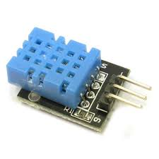
HARDWARE COMPONENTS:
1:DHT-11 Sensor
DHT -11 sensor is a Temperature-Humidity Sensor .
This module can be applied to environmental temperature & humility measurement.
Operating voltage 3.3V-5.5V
Pin No. Symbol Descriptions
1 DOUT Communication port
2 GND Power ground
3 VCC Positive power supply (3.3V-5.5V)

Slide 4
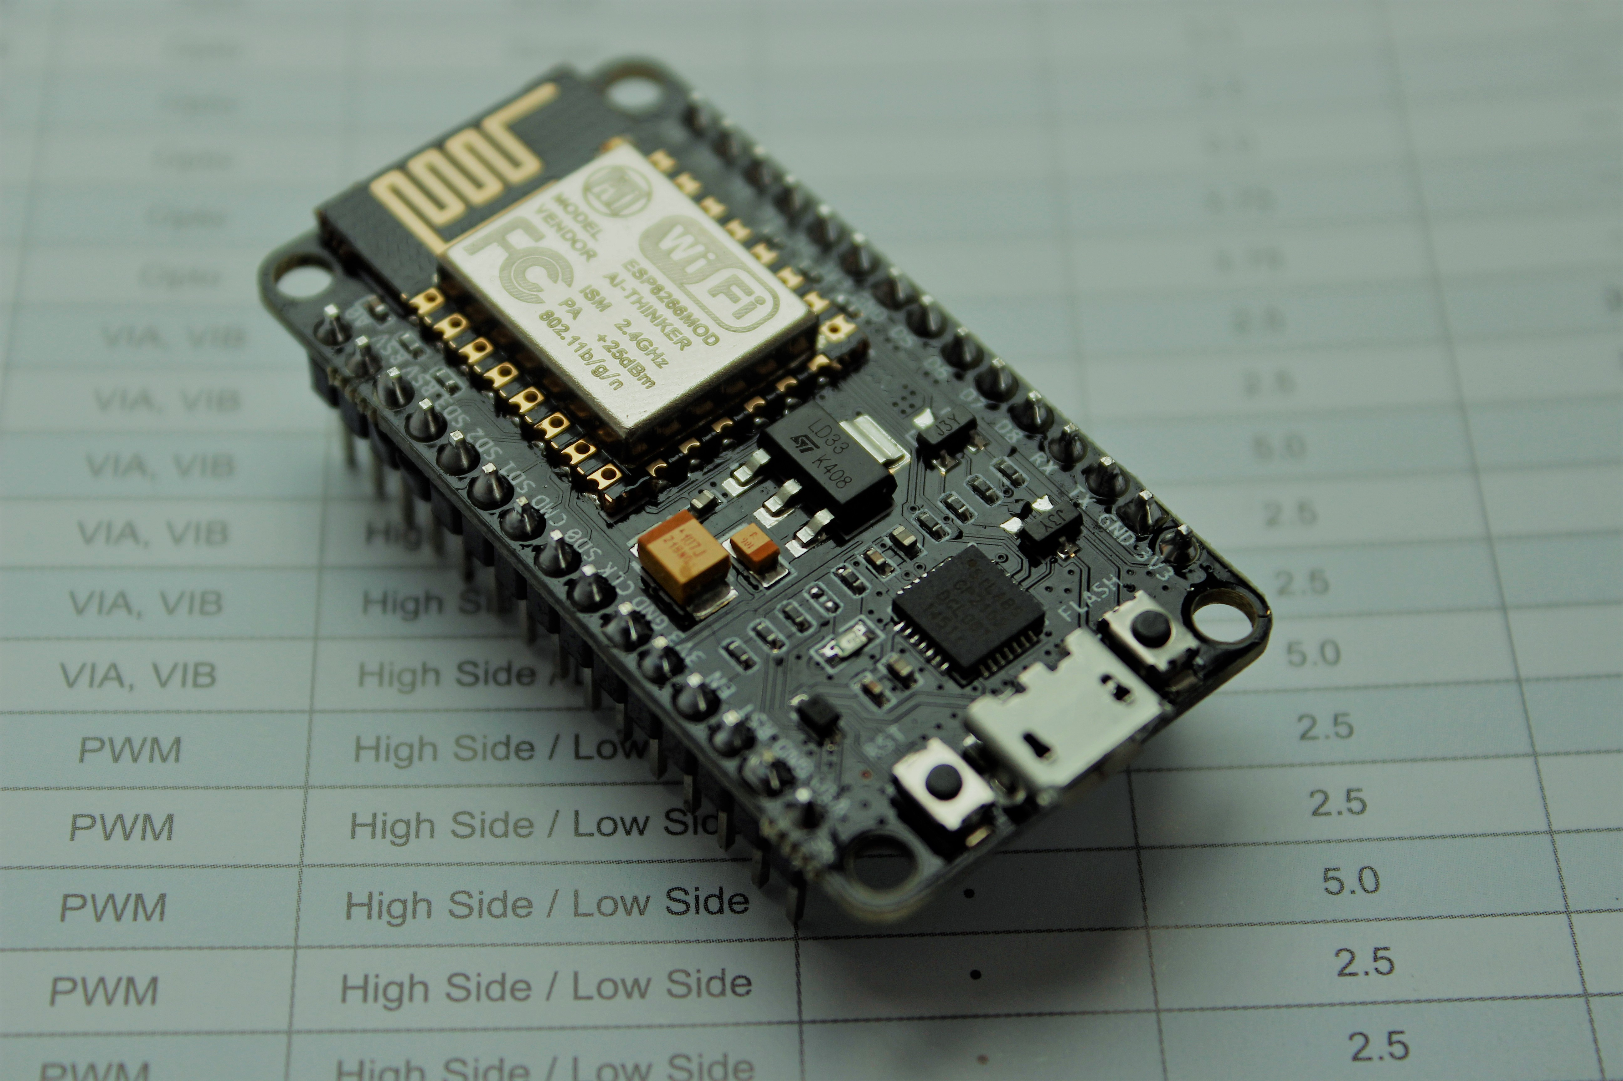
2:Nodemcu ESP8266
I/O index ESP8266 pin
0 [*] GPIO16
1 GPIO5
2 GPIO4
3 GPIO0
4 GPIO2
5 GPIO14
6 GPIO12
7 GPIO13
8 GPIO15
9 GPIO3
10 GPIO1
11 GPIO9
12 GPIO10
NodeMCU is an open source Lua based firmware for the ESP8266 Wi-Fi SOC from Espressif and uses an on-module flash-based SPIFFS file system. NodeMCU is implemented in C and is layered on the Espressif NON-OS SDK.
The firmware was initially developed as is a companion project to the popular ESP8266-based NodeMCU development modules, but the project is now community-supported, and the firmware can now be run on any ESP module

Slide 5
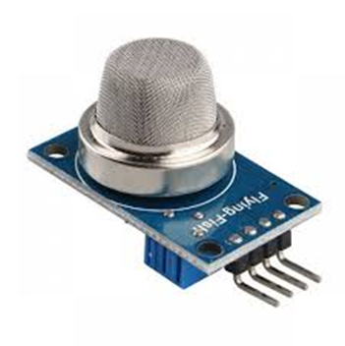

3:MQ-135
Air quality sensor for detecting a wide range of gases, including NH3, NOx, alcohol, benzene, smoke and CO2. Ideal for use in office or factory. MQ135 gas sensor has high sensitivity to Ammonia, Sulfide and Benze steam, also sensitive to smoke and other harmful gases. It is with low cost and particularly suitable for Air quality monitoring application.
Features:
High Sensitivity.
High sensitivity to Ammonia, Sulfide and Benzene.
Stable and Long Life.
Detection Range: 10 - 300 ppm NH3, 10 - 1000 ppm Benzene, 10 - 300 Alcohol.
Heater Voltage: 5.0V.
Dimensions: 18mm Diameter, 17mm High excluding pins, Pins - 6mm High
Long life and low cost

Slide 6

4:MQ-2
The Grove - Gas Sensor(MQ2) module is useful for gas leakage detection (home and industry). It is suitable for detecting H2, LPG, CH4, CO, Alcohol, Smoke or Propane. Due to its high sensitivity and fast response time, measurement can be taken as soon as possible. The sensitivity of the sensor can be adjusted by potentiometer.
Features:
• Wide detecting scope
• Stable and long lifetime
• Fast response and High sensitivity
Application Ideas:
• Gas leakage detection.
• Toys.

Slide 7
Software Components:
1:Aurdino IDE
2:IBM Watson cloud platform

Slide 8
THANK YOU

Slide 9
DONE BY
- INNOVATORS
D. Madhuri
G.Kavya
P. Venkat sai

